Slide 1

Introduction TO OPERATING SYSTEM & Role of os
Group 1 :
Sachin Rajbhar
Ritik kumar
shubham
Sachin kumar singh
Harsh Kumar

Slide 2
INDEX
No. of Pages
NEED? (1)
What is OS? (2)
Examples (1)
Goals (1)
Role of OS (1)
Summary (1)

Slide 3
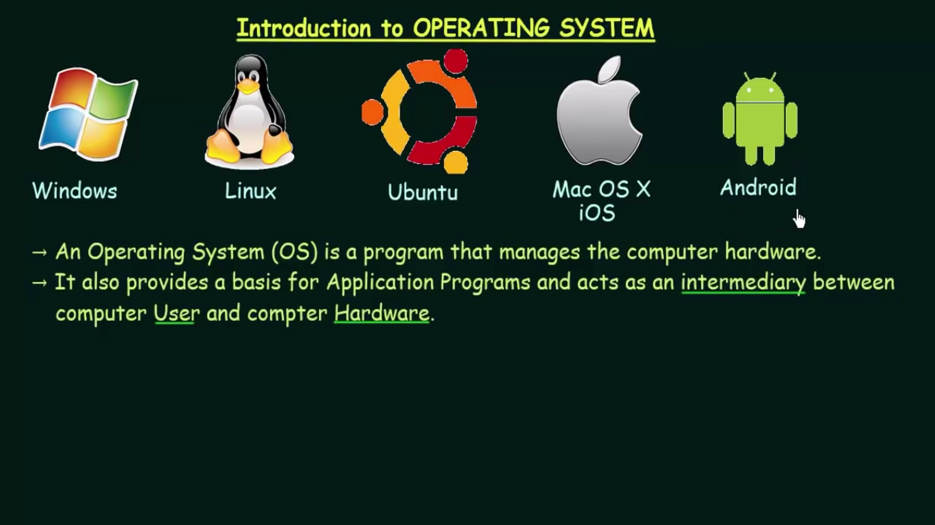

Slide 4
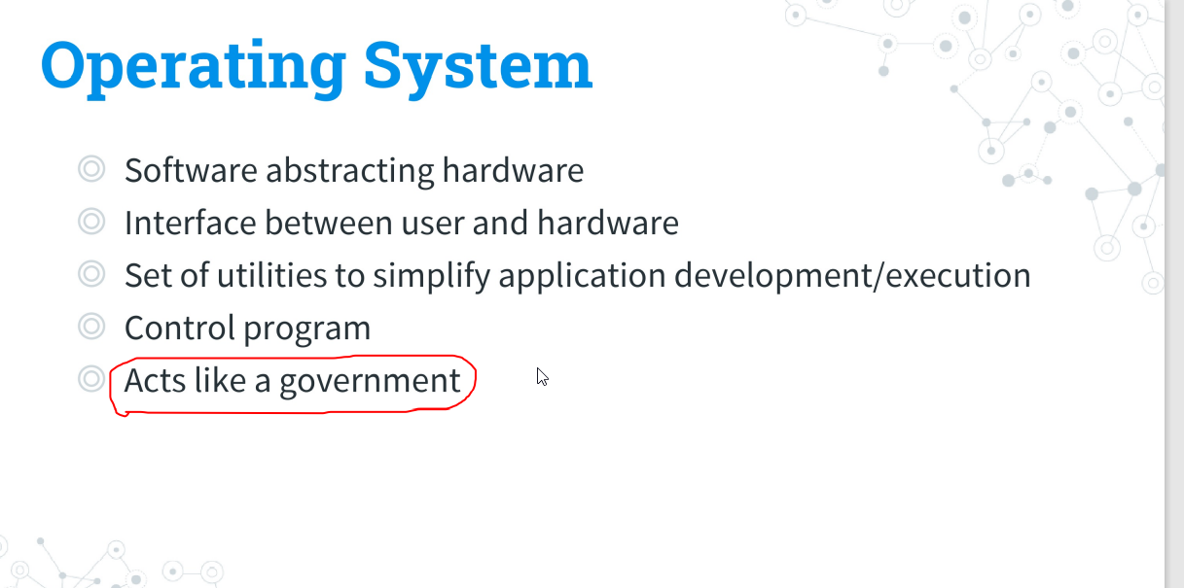

Slide 5
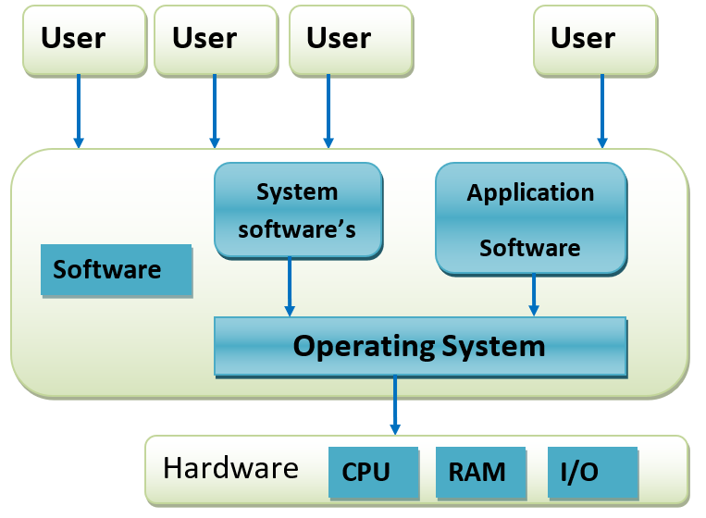

Slide 6
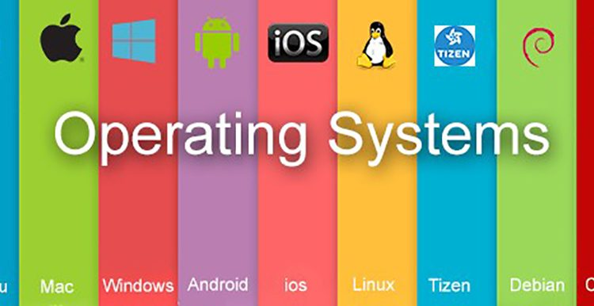








Slide 7
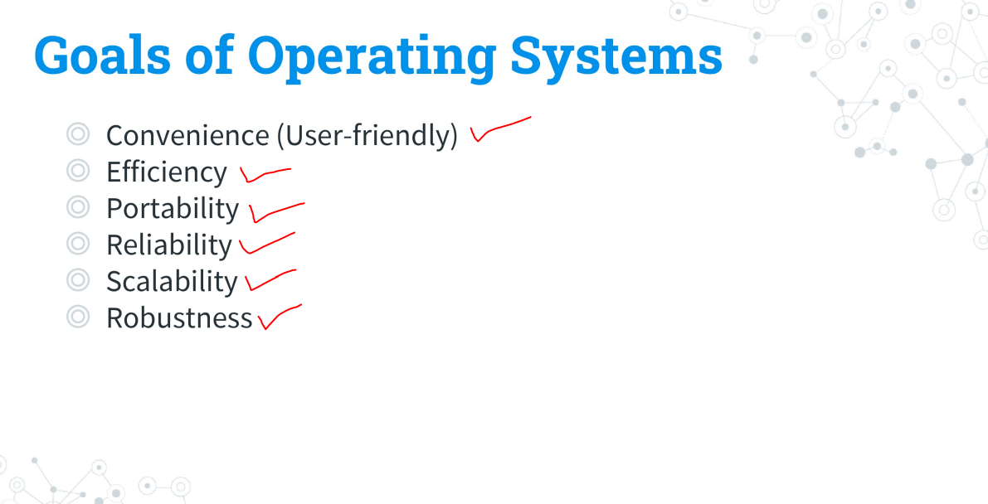

Slide 8
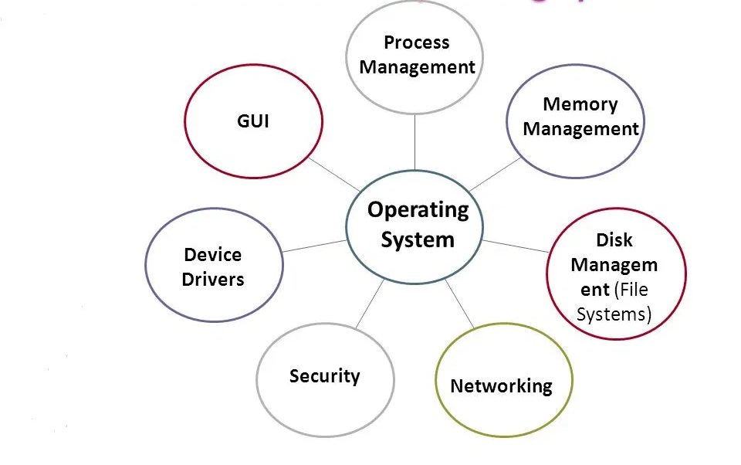
Roles/features of os

Slide 9
Summary
What is OS?
Ans: An operating system (OS) is system software that manages computer hardware, software resources, and provides common services for computer programs.
Roles of OS?
Ans: Process Management, Memory Management, File Management, Networking, Security, Device Drivers, GUI

Slide 10

to be continued..
Group II

